Slide 1


Build a Personalized Online Course Recommender System with Machine Learning
Vasantan Govinda Raju
15 Feb 2025

Slide 2

Outline
Introduction and Background
Exploratory Data Analysis
Content-based Recommender System using Unsupervised Learning
Collaborative-filtering based Recommender System using Supervised learning
Conclusion
Appendix

Slide 3
Introduction
Background & Context
Online learners struggle to find the right courses.
A personalized recommender system can improve engagement.
Problem Statement
Goal: Suggest relevant courses using machine learning.
Approach: Use content-based & collaborative filtering.

Slide 4

Exploratory Data Analysis

Slide 5
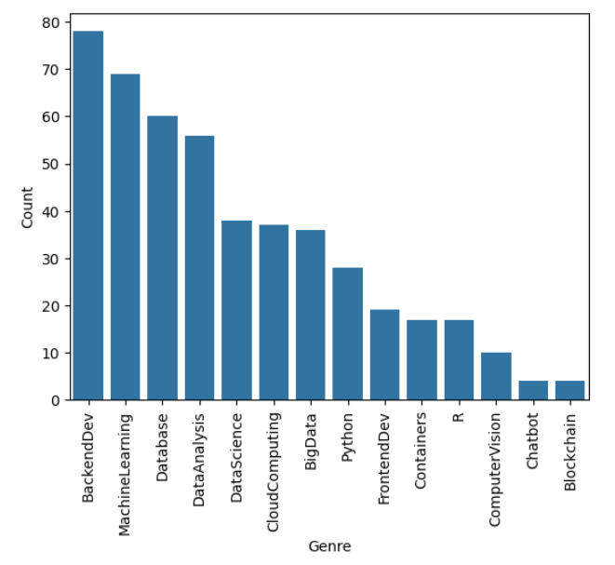
Course Counts Per Genre
Backend Development has the most courses, followed by Machine Learning and Databases.
Niche fields like Chatbots, Blockchain, and Computer Vision have fewer courses.
The trend shows high availability in popular tech fields and limited options in specialized areas.
This helps in better course recommendations based on user interest.

Slide 6
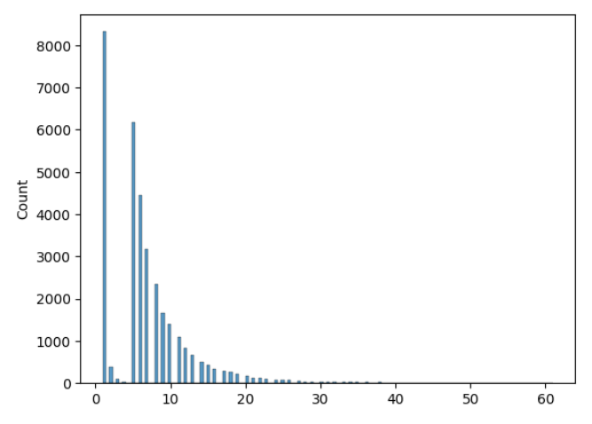
Course Enrollment Distribution
Most users enroll in only a few courses, with a sharp drop as the number of enrollments increases.
A small number of users enroll in many courses, creating a long-tail effect.
This suggests that most learners are selective, while a few explore widely.
Helps in personalized recommendations by understanding user engagement patterns

Slide 7
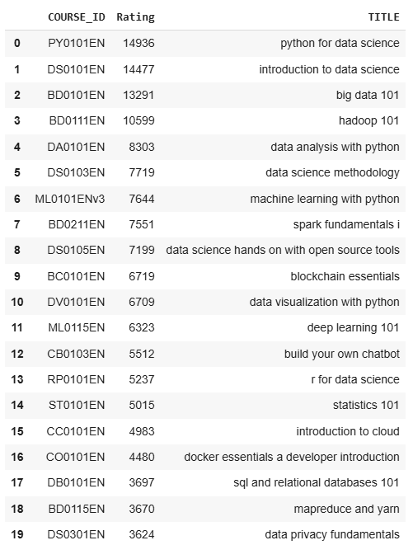
20 Most Popular Courses
The list showcases the top 20 courses based on enrollment or rating.
Python for Data Science ranks highest, followed by Introduction to Data Science and Big Data 101.
Data Science, Machine Learning, and Cloud Computing dominate the top spots.
This insight helps refine recommendations by prioritizing highly sought-after courses.

Slide 8
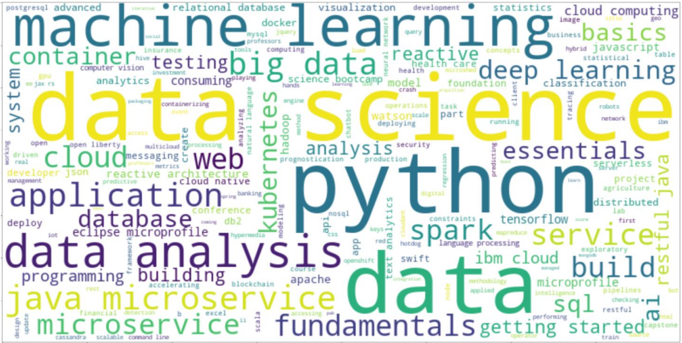
Word Cloud of Course Titles

Slide 9
Content-based Recommender System using Unsupervised Learning
Cluster2
Cluster1

Slide 10
Flowchart of Content-Based Recommender System Using User Profile and Course Genres
The recommender system compares user preferences with course genres using vector representations.
Dot product calculation measures similarity between the user profile and course genres.
If the similarity score exceeds a threshold, the course is recommended; otherwise, it is not recommended.
Yes
Add course to recommended list
Check whether dot product score more than threshold
User profile vector
Dot product
Course genre vector
No
Do not recommend the course

Slide 11
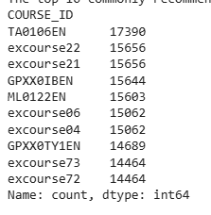
Evaluation Results of User Profile-Based Recommender System
Threshold score: 10.0
On average, 60.82 new courses have been recommended per test user.
The top-10 commonly recommended courses across all test users are listed

Slide 12
Flowchart of Content-Based Recommender System Using Course Similarity
Uses a similarity matrix to compare enrolled and unselected courses
Recommends courses if similarity exceeds the threshold
Yes
Add course to recommended list
Enrolled course
Check if similarity more than threshold
Similarity matrix
Unselected Course
No
Do not recommend the course

Slide 13
Evaluation Results of Course Similarity Based Recommender System
Threshold for similarity : 0.6

Slide 14
Flowchart of Clustering-Based Recommender System
User profile data is cleaned and transformed into numerical features relevant for clustering, such as course preferences, activity history, and demographics.
An unsupervised learning algorithm (e.g., K-Means) groups similar users into clusters based on these features.
The clustering model is optimized by adjusting parameters like the number of clusters to ensure accurate groupings.
Each user is assigned to a specific cluster. Generate course based on popular course within cluster
Generate courses recommendation based on popular course within cluster
Preprocessing and Feature Engineering
Clustering model
Hyperparameter tuning
Combine/group user to cluster label

Slide 15
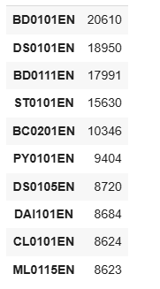
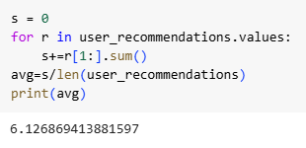
Evaluation Results of Clustering-Based Recommender System
Number of cluster : 14
PCA component : 9
On average, how many new/unseen courses have been recommended per user
Top-10 commonly recommended courses

Slide 16
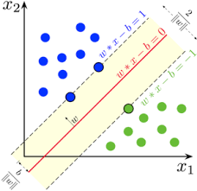
Collaborative-filtering Recommender System using Supervised Learning

Slide 17
Flowchart of KNN Based Recommender System
Captures the history of course enrollments by users.
Implements the K-Nearest Neighbors algorithm to find similar users or courses based on enrollment patterns.
Divides the data into training and testing sets to evaluate performance.
Recommends courses to users based on similar users’ enrollments.
User-Item Interaction Matrix
KNN Model Application
Train-Test Split
Make Prediction

Slide 18
Flowchart of NMF Based Recommender System
Constructed User-Item Interaction Matrix from course enrollments.
Non-negative Matrix Factorization (NMF): Decomposes the matrix into user and item feature matrices.
Model Training: Implemented using Scikit Surprise with hyperparameter tuning.
Train-Test Split: Data is divided to validate predictions.
Prediction Generation: Reconstructs missing values for personalized course recommendations.
User-Item interaction matrix
Non-negative Matrix Factorization (NMF):
Model Training
Train-Test Split
Prediction Generation

Slide 19
Flowchart of Neural Network Embedding Based Recommender System
User one-hot encoding vector and Course one-hot encoding vector are created.
Both vectors are passed into an Embedding layer that transforms them into dense, low-dimensional vectors.
The embeddings are fed into a Neural Network Training process.
A Loss Function optimization step minimizes the prediction error.
Finally, the trained model generates Predictions of course recommendations for users.
User one hot encoding vector
Embedding
Neural Network Training
Loss Function optimization
Prediction
Course one hot encoding vector

Slide 20
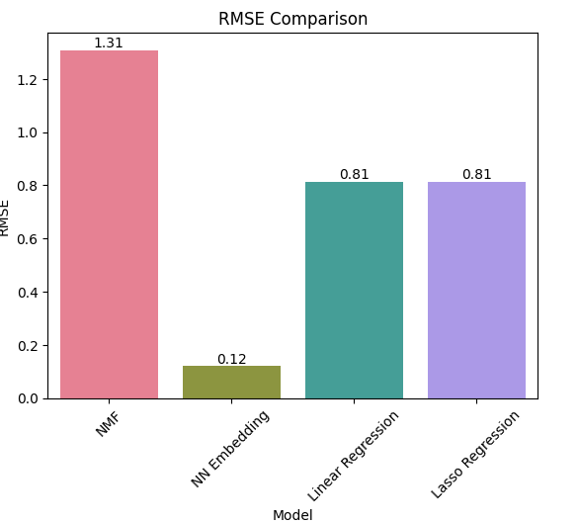
Compare The Performance of Collaborative-Filtering Models
This bar chart compares the RMSE of collaborative-filtering models: NMF, Neural Network Embedding, Linear Regression, and Lasso Regression.
Note: KNN model performance is not included as the training could not be completed due to memory constraints, causing a system crash.

Slide 21
Conclusions
Developed multiple collaborative filtering models for personalized course recommendations.
Neural Network Embedding model had the lowest RMSE, excelling in handling sparse data and complex interactions.
NMF and regression models showed promising results.
KNN model could not be evaluated due to memory constraints.
Future work: Optimize KNN implementation, explore hybrid models, and enhance user profiling for better recommendations.

Slide 22
Appendix
All material, notebook link available at
https://github.com/Vasantan/IBM-Machine-Learning

